Slide 1
A Battle to Neighborhood - II
A Capstone Project
Finding the best place of 3 bedroom apartment in Manhattan on Rent
By : Yogesh Balkrishna Salve
September 23, 2019

Slide 2
Problem:
The challenge is to find a suitable apartment for rent in Manhattan that complies with the demands on location, price and venues. This project aims to predict the best location for the apartment with which fulfills the demands on price and venues.

Slide 3
Interest:
I believe this is a relevant challenge with valid questions for anyone moving to other large city in US or Asia The same methodology can be applied in accordance to demands as applicable. This case is also applicable for anyone interested in exploring starting or locating a new business in any city. Lastly, it can also serve as a good practical exercise to develop Data Science skills

Slide 4
The following data is required to answer the issues of the problem:
1. List of Boroughs and neighborhoods of Manhattan with their
geodata (latitude and longitude)
2. List of Subway metro stations in Manhattan with their address
location
3. List of apartments for rent in Manhattan area with their addresses and price
4. Preferably, a list of apartment for rent with additional information, such as price, address, Area, no. of beds, etc
5. Venues for each Manhattan neighborhood (than can be clustered)
6. Venues for subway metro stations, as needed

Slide 5
The analysis and the strategy
What is the cost of available rental places that meet the demands?
What is the cost of rent around a mile radius from each subway metro station?
What is the area of Manhattan with best rental pricing that meets criteria established?
What is the distance from work place (Park Ave and 53 rd St) and the tentative future rental home?
What are the venues of the two best places to live? How the prices compare?
How venues distribute among Manhattan neighborhoods and around metro stations?
Are there tradeoffs between size and price and location?

Slide 6
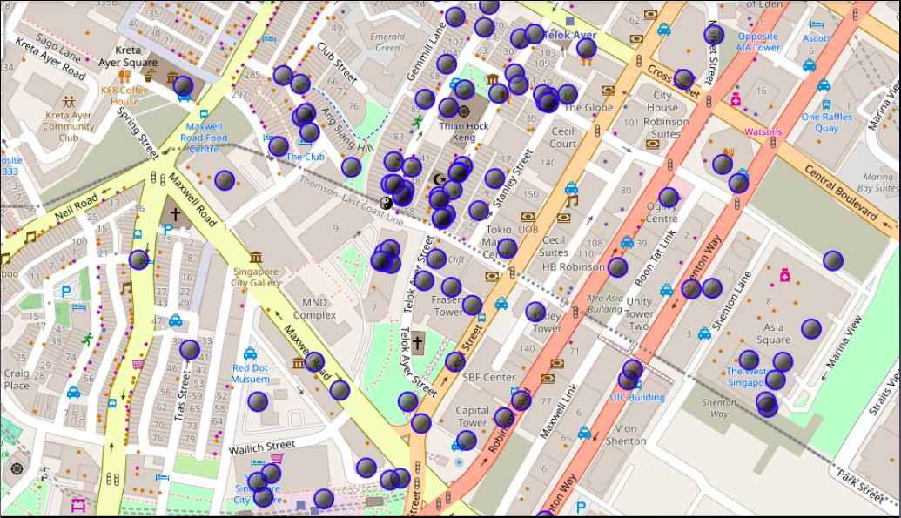
Execution and Result
Current Residence neighborhood in Singapore

Slide 7
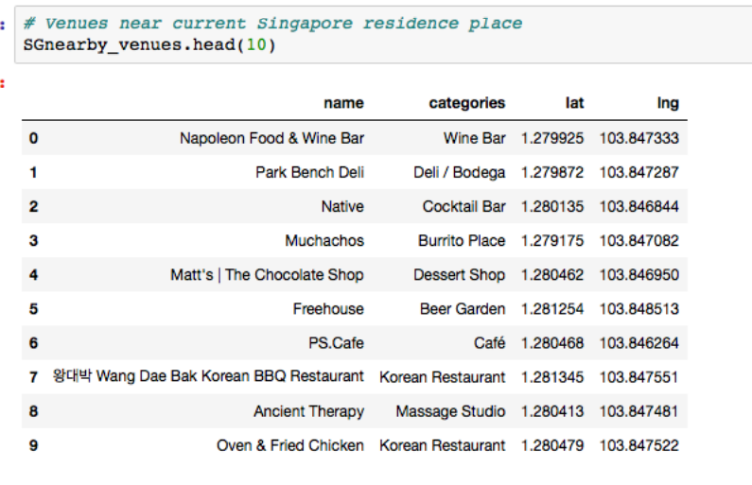
Venues around neighborhood in:

Slide 8
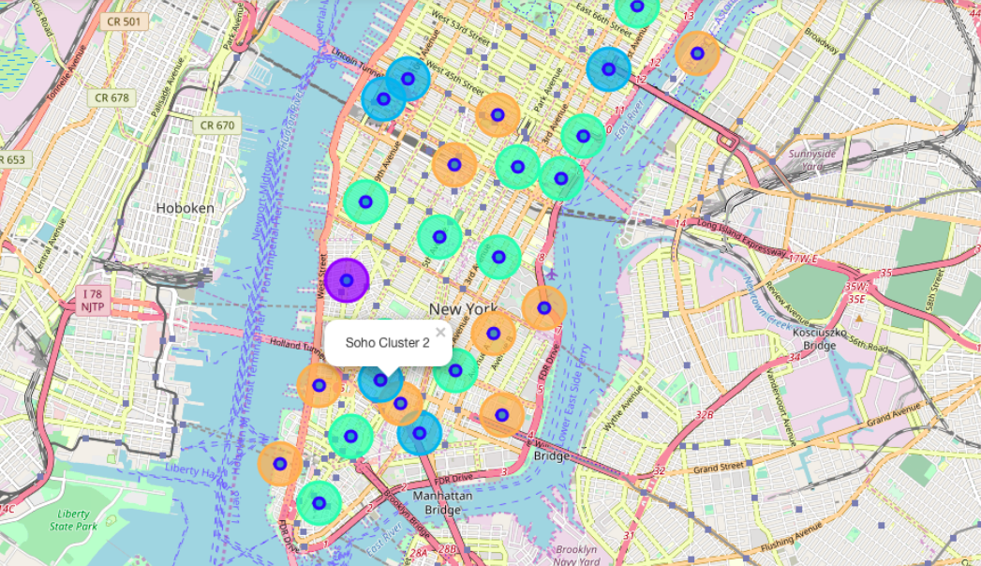
Manhattan Map – Neighborhoods and cluster of venues

Slide 9
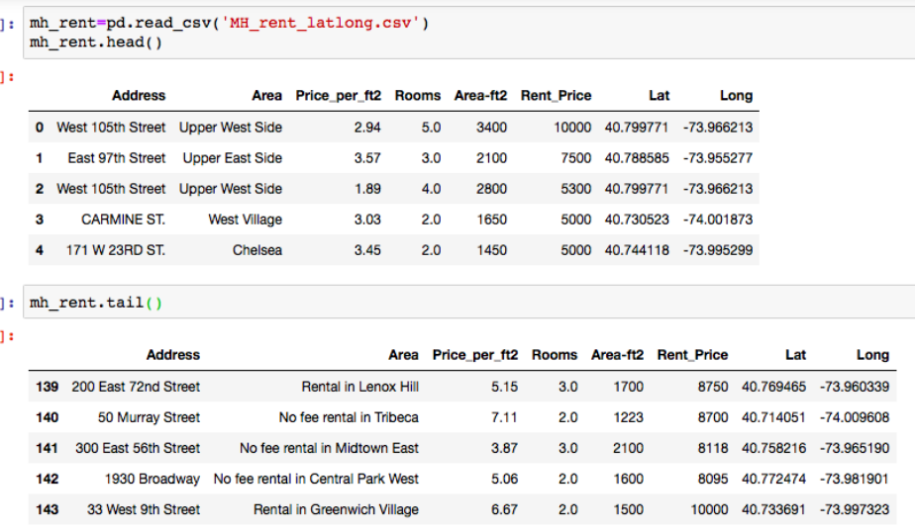
Geodata: Manhattan Apartment for rent

Slide 10
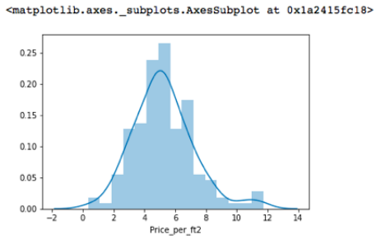
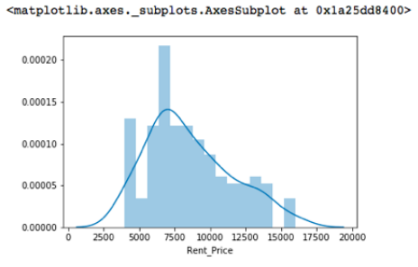
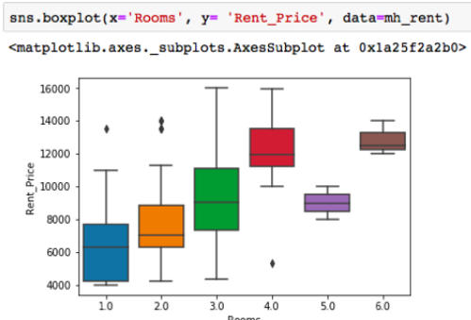
Rental Price Statistics Manhattan Apartments

Slide 11
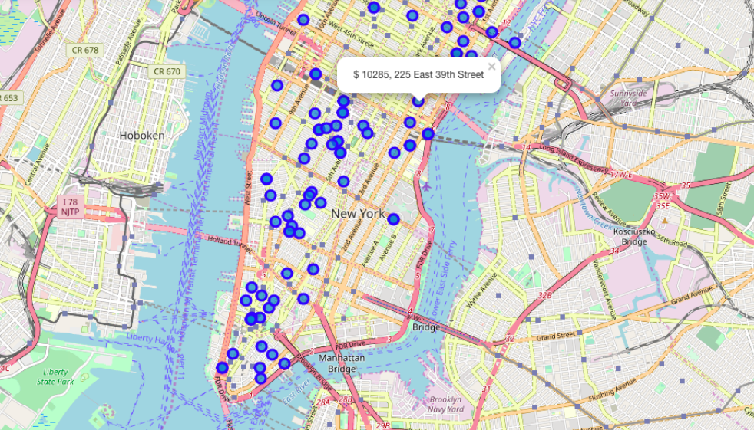
Apartments for rent in Manhattan:

Slide 12
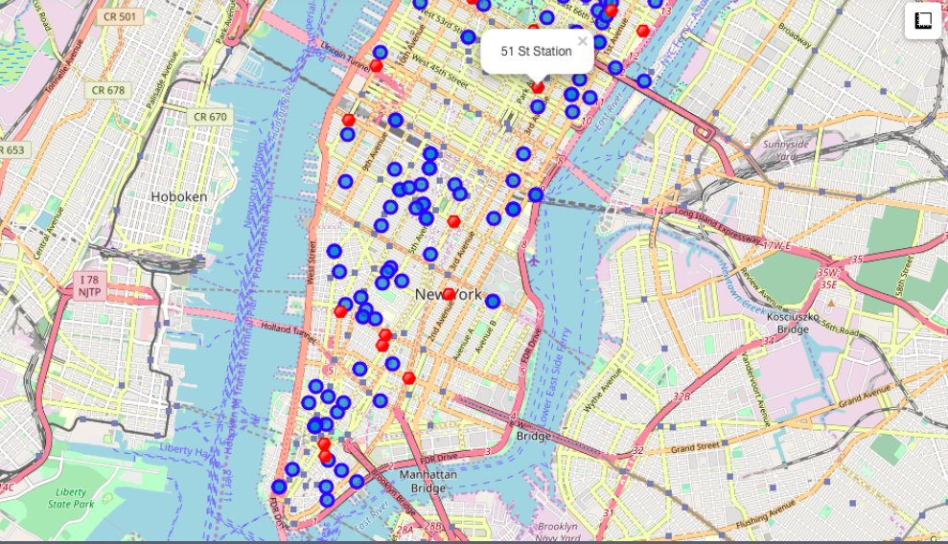
Apartments for Rent Shown in Blue and
Subway Stations are shown in Red

Slide 13
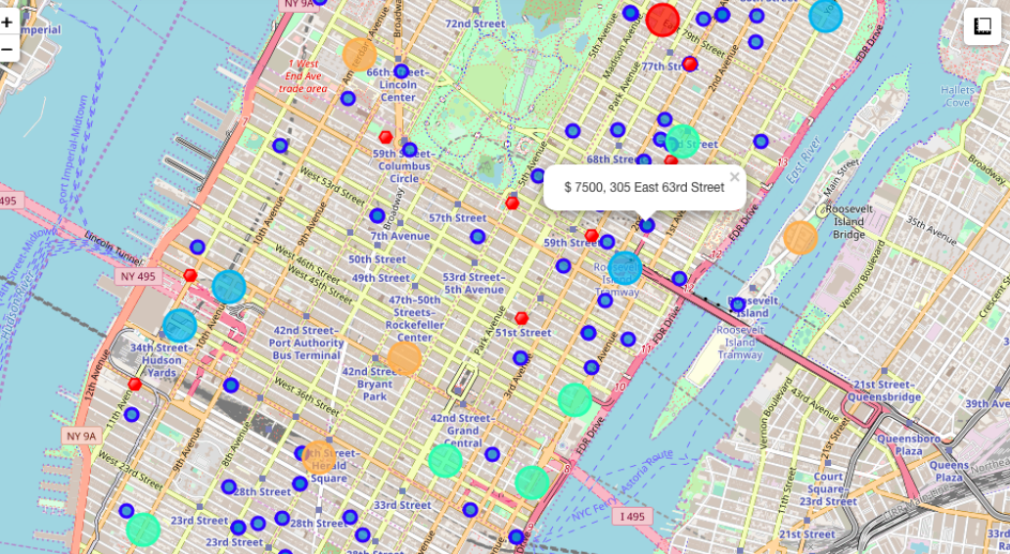
Apartment is to be selected in a way that,
The rent is near about equal to $7000 in my budget.

Slide 14
Conclusion:
Based on the given constraints, a apartment on rent in Manhattan can be taken in a place closer to Murray Hills , which will take your rent less than $7000 and all the basic needs can be fulfilled due to near metro station.

Slide 15
Thank You
Yogesh Balkrishna Salve

